Slide 1
Compression opportunities using progressive meshes
Hugues Hoppe
Microsoft Research
SIGGRAPH 98 course: “3D Geometry compression”

Slide 2
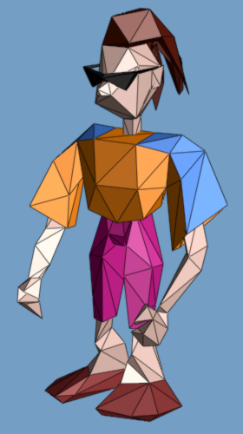
Triangle Meshes
{f₁} : { v₁ , v₂ , v₃ }
{f₂} : { v₃ , v₂ , v₄ }
…
connectivity
{v₁} : (x,y,z)
{v₂} : (x,y,z)
…
geometry
{f₁} : “skin material”
{f₂} : “brown hair”
…
face attributes
Notes:
In computer graphics, geometric models are commonly represented as triangle meshes.
As shown here, a mesh consists of a set of triangular faces pasted together along their edges and meeting at a common set of vertices.
In a traditional representation, a mesh is represented as a set of vertices containing xyz coordinates, and a set of faces containing indices referring back to the vertices.
Besides geometry, other appearance attributes are often present in a mesh, such as vertex normals, vertex colors, material attributes, and texture maps. These appearance attributes are also associated with the vertices and faces of the mesh.

Slide 3
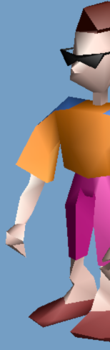
Triangle Meshes
{f₁} : { v₁ , v₂ , v₃ }
{f₂} : { v₃ , v₂ , v₄ }
…
connectivity
{v₁} : (x,y,z)
{v₂} : (x,y,z)
…
geometry
{f₁} : “skin material”
{f₂} : “brown hair”
…
face attributes
{v₂,f₁} : (n_{x},n_{y},n_{z}) (u,v)
{v₂,f₂} : (n_{x},n_{y},n_{z}) (u,v)
…
corner attrib.

Slide 4
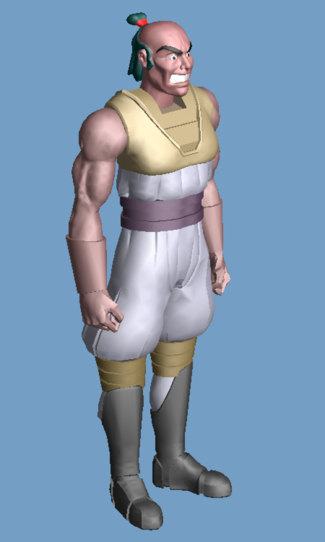
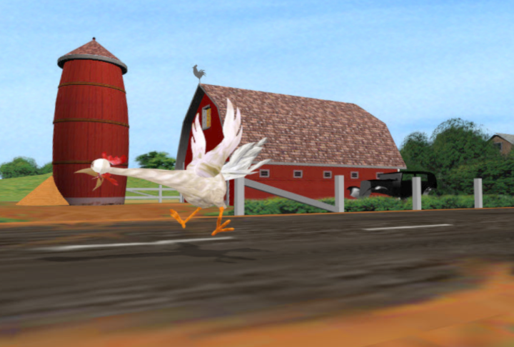
Complex meshes
43,000 faces
lots of faces!
Challenges:
- rendering
- storage
- transmission
geometry
compression
Notes:
There is a growing expectation for realism in computer graphics, and as a result geometric models are becoming very complex.
And, computer graphics scenes are typically composed of many meshes, so the overall complexity can be huge.
This presents several challenges, because of limitations in rendering performance, storage capacities, and transmission bandwidths.

Slide 5
Talk outline
Progressive mesh (PM) representation
Analysis of PM compression
Improved PM compression
Progressive simplicial complex (PSC) repr.

Slide 6
Progressive mesh representation
Basic idea:
Simplify arbitrary mesh through sequence of transformations.
Record:
simplified mesh
+
sequence of inverse transformations
Notes:
I’ll now introduce the progressive mesh representation.
The basic idea is to simplify an arbitrary mesh through a sequence of transformations, and while doing so, to record the sequence of inverse transformations that are sufficient to reconstruct the original mesh from the simplified one.

Slide 7
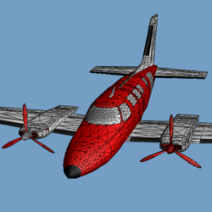
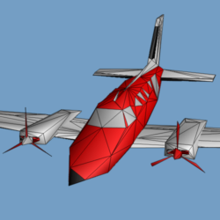
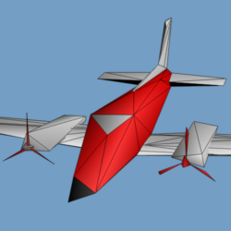
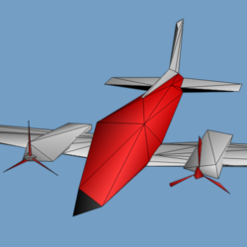
Simplification: Edge collapse
ecol(v_{s} ,v_{t} , v_{s} )
’
v_{t}
v_{l}
v_{r}
v_{l}
v_{s}
v_{r}
’
v_{s}
(optimization)
13,546
500
152
150 faces
M^{n}
M¹⁷⁵
M¹
M⁰
ecol_{n-1}
ecol_{i}
ecol₀
Notes:
An edge collapse transformation takes two vertices adjacent to an edge of the mesh, and unifies them into one. In the process, one or two faces of the mesh are deleted.
Of course, there is an optimization procedure for selecting what edges to collapse (and in what order), and what position and attributes to assign to the resulting vertex. I’ll return to that topic in a few slides.
Thus, from the original mesh, denoted M^n, we apply a sequence of edge collapse transformations to obtain a very coarse base mesh, M^0.
You can see the effect of the very last edge collapse transforming M^1 into M^0; it removes the last window from the airplane.

Slide 8
Invertible! Vertex split transformation
attributes
vspl(v_{s} ,v_{l} ,v_{r} , v_{s} ,v_{t} ,…)
’
’
’
v_{t}
v_{l}
v_{s}
v_{r}
v_{l}
v_{r}
v_{s}
’
Notes:
A key observation is that the edge collapse transformation is invertible. Its inverse is called a “vertex split”.
This operation takes as parameters a vertex v_s along with two of its neighbors v_l and v_r. It splits v_s into two vertices, creating two new faces in the process.
The vertex split record also stores the positions of the two split vertices as well as other appearance attributes associated with the new neighborhood.

Slide 9
Reconstruction process
150
152
500
13,546
M⁰
M¹
M¹⁷⁵
M^{n}
M⁰
M^{n}
vspl₀
… vspl_{i} …
vspl₀
… vspl_{i} …
vspl_{n-1}
vspl_{n-1}
progressive mesh (PM) representation
Notes:
We can therefore flip the previous diagram, starting with the base mesh M^0, and apply to it a sequence of vertex split transformations.
The first vertex split introduces one vertex and two faces; subsequent vertex splits recover more and more detail; and, after all vertex splits have been applied, the original mesh M^n is recovered exactly.
Therefore, the base mesh M^0 together with the sequence of vertex split records forms an alternate representation for the mesh. This is what I refer to as the progressive mesh representation.
It is equivalent to knowing the original mesh. It just expresses it in a different format.

Slide 10
PM benefits
M^{n}
PM
V^{n}
lossless
F^{n}
M⁰
vspl
attributes
single resolution
progressive transmission
continuous-resolution
smooth LOD
geometry compression
Notes:
To summarize, a mesh is traditionally represented as a set of vertices and a set of faces.
Such a mesh can be converted losslessly into a progressive mesh representation, composed of a base mesh and a sequence of vertex split records.
This new representation has a number of nice properties.
It captures a continuous-resolution family of approximations; it supports smooth level-of-detail; it is space-efficient; and, it can be transmitted progressively.

Slide 11
Application: Progressive transmission
Transmit records progressively:
time
M⁰
vspl₀
vspl₁
vspl_{i-1}
vspl_{n-1}
Receiver
displays:
M⁰
M^{i}
M^{n}
(~ progressive GIF & JPEG)
Notes:
As you may already have guessed, progressive meshes are a natural representation for progressive transmission.
The base mesh is transmitted first, in a traditional format, followed by the stream of vertex split records.
The receiving process can quickly display this coarse base mesh.
Then, as more and more vertex split records arrive, it can at any point in time display the mesh constructed so far. Reconstruction can proceed at over 100,000 faces per second.
At the end of transmission, the original mesh has been recovered exactly.
Note that this is analogous to the way that images are transmitted over the Web using progressive GIF and JPEG.

Slide 12
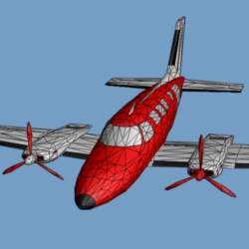
Application: Continuous-resolution LOD
From PM, extract M^{i} of any desired complexity.
3,478 faces?
M⁰
vspl₀
vspl₁
vspl_{i-1}
vspl_{n-1}
3,478
M^{i}
M⁰
M^{n}
M^{i}
~400K faces/sec!
~400K faces/sec!
(200 MHz Pentium Pro)
Notes:
I’ll now discuss several advantages of this progressive mesh representation.
First, it is a continuous-resolution representation. What I mean by this is that from it one can recover approximating meshes of any desired complexity. This is achieved by applying to the base mesh a prefix of the vertex split sequence.
So if one wants to recover a mesh with 3,478 faces, it can be retrieved very efficiently.
In effect, this defines a continuous family of approximating meshes (from the base mesh M^0 to the original mesh M^n), and we can iterate through these meshes by applying edge collapses and vertex splits.
In fact, this can be done very efficiently. On a Pentium processor, we obtain a reconstruction rate of about 100,000 faces/sec, and a simplification rate of about 200,000 faces/sec.

Slide 13
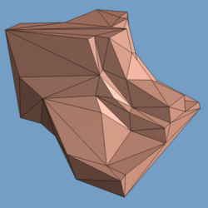
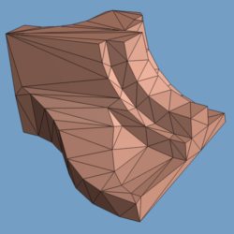
Property: Vertex correspondence
M^{f}
M^{f-1}
M^{f-2}
M^{c}
M^{n}
v₁
v₁
v₁
v₁
M⁰
v₂
v₂
v₂
v₂
v₃
v₃
ecol
v₃
ecol
v₃
v₄
v₄
v₄
v₅
ecol
v₅
v₅
v₆
v₆
v₆
v₇
v₇
v₈
Notes:
Another nice property is that there exists a natural correspondence between vertices of any two meshes in the family of approximations.
So, here are two meshes, a finer mesh M^f and a coarser mesh M^c.
From the finer mesh, each edge collapse unifies two vertices of the mesh into one, and this occurs repeatedly until the coarser mesh is obtained.
Now we see a correspondence between vertices of the various meshes.

Slide 14
Application: Smooth transitions
M^{f}
M^{c}
M^{n}
v₁
v₁
M⁰
v₂
v₂
v₃
v₃
v₄
v₅
v₆
M^{f↔c}
v₇
V
V
F
v₈
→ can form a smooth
visual transition: geomorph
Notes:
When we fold together all of these correspondences, we find that they form a surjection, or “onto map” from the vertices of the finer mesh onto the vertices of the coarser mesh.
This allows us to define a smooth visual transition, or geomorph, between these two meshes.
We simply take the finer mesh M^f, and for each of its vertices, interpolate between its current position and the position of its corresponding vertex in the coarser mesh.

Slide 15
BUT, geometry compression?
M⁰
vspl₀
vspl₁
vspl_{i-1}
vspl_{n-1}
M^{n}
M₀ is typically small
key is encoding of vspl_{i}

Slide 16
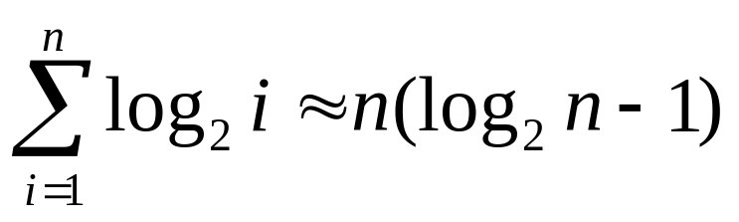
Vertex split encoding
Record:
vspl_{i} (v_{s} ,v_{l} ,v_{r} ,v_{s} ,v_{t} ,…)
’
’
  v_{s} (log₂i bits)
v_{t}
  v_{l} & v_{r} (~5 bits)
’
v_{l}
v_{r}
v_{l}
v_{r}
v_{s}
v_{s}
’
Analysis:
  connectivity: n(log₂n+4) bits vs. n(6log₂n) bits
Notes:
In addition, PM is an effective scheme for compressing meshes. The key is that each vertex split applies a local perturbation to the mesh that can be encoded concisely. Let us consider the various parameters of a vertex split record.
First, the vertex v_s must be specified among the vertices of the mesh reconstructed so far. Since there are i vertices in iteration i, this requires log_2 i bits. The vertices v_l and v_r can be specified among the neighbors of v_s and on average this requires only about 5 bits.
Overall, encoding the mesh connectivity requires about n(log_2 n+4) bits, which is much smaller than a traditional IndexedFaceSet representation. It’s about as concise as triangle strips, but not as optimal as work by [Deering95] or [Taubin&Rossignac96].

Slide 17
Vertex split encoding
Record:
vspl_{i} (v_{s} ,v_{l} ,v_{r} ,v_{s} ,v_{t} ,…)
’
’
  v_{s} (log₂i bits)
v_{t}
  v_{l} & v_{r} (~5 bits)
’
v_{l}
v_{r}
v_{l}
v_{r}
’
v_{s}
  v_{t} - v_{s} (delta)
  v_{s} - v_{s} (delta)
v_{s}
’
’
Analysis:
  connectivity: n(log₂n+4) bits vs. n(6log₂n) bits
  geometry: ~40n bits vs. 96n bits
16-bit quantization & variable-length encoding [Deering95]
Notes:
Now let’s examine the mesh geometry. The positions of the two new split vertices can be specified as deltas from the position of the old vertex, and since the deltas are small in magnitude, this can be encoded more concisely than absolute positions. Using the variable-length delta encoding of [Deering95], we significantly compress the geometry.

Slide 18
Vertex split encoding
Record:
vspl_{i} (v_{s} ,v_{l} ,v_{r} ,v_{s} ,v_{t} ,…)
’
’
  v_{s} (log₂i bits)
v_{t}
  v_{l} & v_{r} (~5 bits)
’
v_{l}
v_{r}
v_{l}
v_{r}
’
v_{s}
  v_{t} - v_{s} (delta)
  v_{s} - v_{s} (delta)
v_{s}
’
’
  predict face attrib.
Analysis:
  connectivity: n(log₂n+4) bits vs. n(6log₂n) bits
  geometry: ~40n bits vs. 96n bits
Notes:
Finally, other attributes such as material properties for the two new faces can be predicted from the neighboring faces. Prediction makes the encoding of material identifiers negligible.

Slide 19
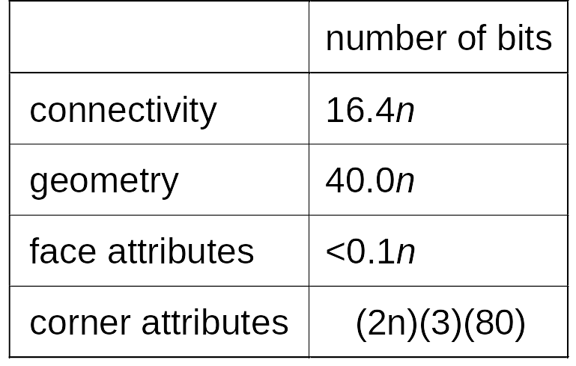
Summary of vsplit encoding
?
42,712 faces
n=21,373
151 Kbytes (ignoring corners)
(n is #vertices, ~2n is #faces)

Slide 20
Improved PM compression
Connectivity
  group vsplits → forest splits [Taubin etal98]
  permute vsplits
Geometry
  apply smoothing [Taubin etal98]
  local prediction + single delta
Face attributes
  already negligible
Corner attributes
  wedge data structure

Slide 21
Compression of connectivity
Detail: f_{lclw} , nrot
v_{l}
v_{s}
v_{r}
Problem: locating vsplit on mesh
(using either f_{lclw} or v_{s} ) requires log₂i bits.

Slide 22
Progressive Forest Split (PFS)
[Taubin,Gueziec,Horn,Lazarus98]
M⁰
vspl₀
vspl₁
vspl₂
vspl₃
vspl₄
vspl₅
vspl_{n-1}
fsplit₀
fsplit₁
fsplit₂
…
fsplit_{logn}
  PM: n(4+log₂n) bits
  PFS: n(8..10) bits

Slide 23
Other solution: permutation of vsplits
M⁰
M⁰
f_{lclw,1}
f_{lclw,2}
Δf_{lclw}
We record Δf_{lclw} and minimize Δf_{lclw} by permuting vsplits.

Slide 24
Legal vsplit permutations
Determine dependencies between vsplits
  [Xia & Varshney 96]
  [Hoppe 97]
  vsplit is candidate if it has no dependencies.
Greedy algorithm:
  Maintain candidate vsplits in balanced tree, sorted by f_{lclw} .
  Remove vsplit with smallest Δf_{lclw} and update candidate tree.

Slide 25
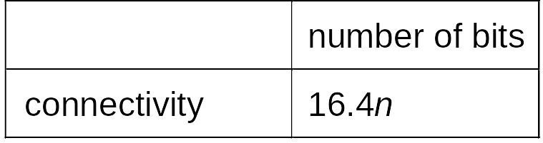
Result of permuting vsplits
9.7n
~(log₂n+4)n
(now linear)
9.7n…10.3n
  Drawback: intermediate meshes M^{i} (0<i<n) lose geometric accuracy.
  O(n log n) bits to undo permutation.

Slide 26
Layered permutations
(mesh complexity
increasing exponentially)
checkpoints
M⁰
vspl₀
vspl₁
vspl₂
vspl₃
vspl₄
vspl₅
vspl₆
vspl₇
vspl₈
vspl₉
vspl₁₀
vspl_{n-1}
M⁰

Slide 27

Results using layered permutations
# checkpoints
growth factor
connectivity
bits (n=#verts)
1
549
9.7n
9
2.00
9.8n
+ 0.1
bit/vert
13
1.63
9.8n
visually
identical to
original PM !
19
1.40
9.9n
24
1.30
10.0n
35
1.20
10.2n
66
1.10
10.5n
20,373
1.00
16.4n

Slide 28
Geometry: local prediction + delta
  Restrict v_{s} to equal v_{s} .
’
v_{t}
’
x
x
v_{s}
v_{s}
’
  Predict position of v_{t}’ .
  Record single delta from prediction,
  in a local coordinate frame.

Slide 29
Result of predicted delta
9.7n
20.9n
?
  Intermediate meshes M^{i} (0<i<n) have
  minor loss in geometric accuracy.

Slide 30
Corner attributes
vertex
face
corner

Slide 31
Wedge data structure
vertex
wedge
face
corner

Slide 32
Vsplit encoding of wedges
(6 new corners)
10 corner continuity booleans
+ 1..6 wedge attribute deltas

Slide 33
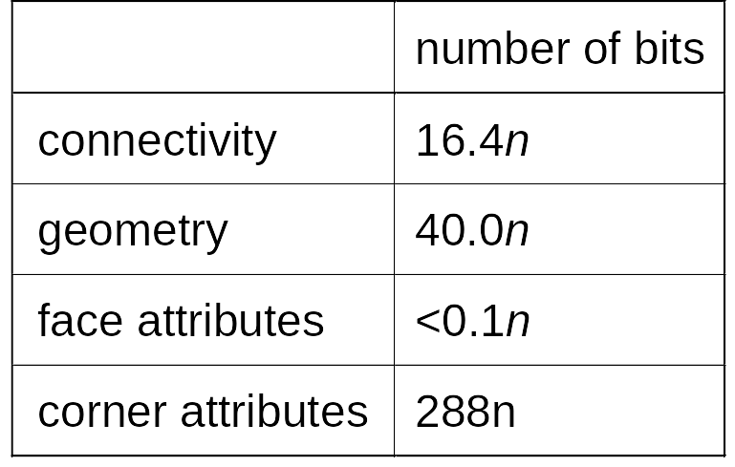
Results using wedges
9.7n
20.9n
23.7n
10 corner continuity booleans : 2.5n bits
wedge attribute deltas : 21.2n bits
(16-bit n_{x},n_{y},n_{z} at corners)

Slide 34

Estimating normals from wedges
9.7n
20.9n
2.5n
original
88 Kbytes

Slide 35
Progressive Simplicial Complexes
[SIGGRAPH 97]
(Joint work with Jovan Popovic)
Notes:
The final part of my talk describes another extension to the progressive mesh work: the progressive simplicial complex representation. It is a generalization that allows the representation of a larger class of models, and allows the progressive representation of both geometry and topology.

Slide 36
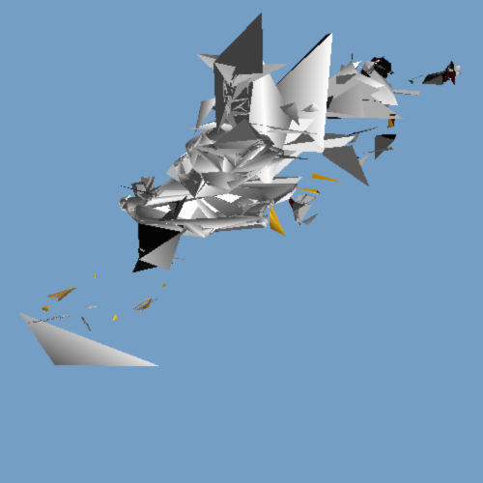
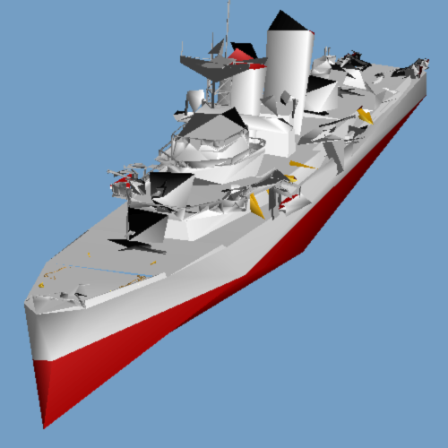
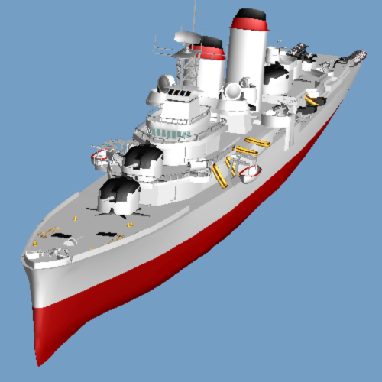
PM restrictions:
Supports only “meshes”
(orientable, 2-dimensional manifolds)
Preserves topological type
M⁰
… M^{i} …
M^{n}
2,522
8,000
167,744
Notes:
The progressive mesh representation has two restrictions.
First, it supports only meshes. That is, 2-d triangulations that form orientable manifolds.
Second, and more importantly, all meshes in the progressive mesh sequence are required to have the same topological type. As a consequence, if the original mesh has a number of connected components, each component is required to appear (in simplified form) in the base mesh M^0. This introduces a lower bound on the complexity of M^0 as shown on the left.

Slide 37
Progressive Simplicial Complexes
Represent arbitrary “triangulations”:
  any dimension,
  non-orientable,
  non-manifold,
  non-regular, …
Progressively encode both geometry
and topology.
Notes:
The progressive simplicial complex representation is able to represent arbitrary triangulations. These may have any dimension, may be non-orientable, non-manifold, and non-regular.
Second, it is able to capture such triangulations by progressively encoding both their geometry and topology.

Slide 38
Generalization
PM
PSC
edge collapse
(ecol)
vertex unification
(vunify)
vertex split
(vspl)
generalized vertex split
(gvspl)
Notes:
The key is to replace the edge collapse / vertex split transformations by the more general vertex unification / generalized vertex split transformations.
The vertex unification transformation takes an arbitrary pair of vertices (not necessarily connected by an edge) and unifies them into one vertex. The generalized vertex split is its inverse.

Slide 39
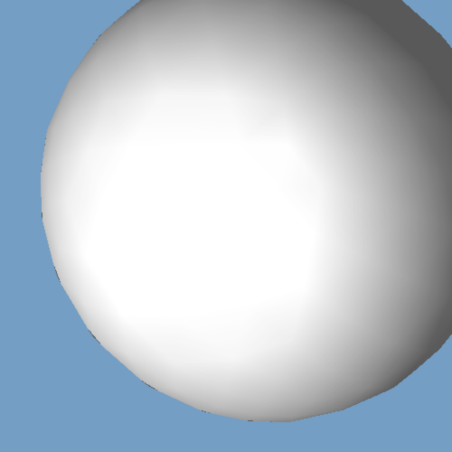
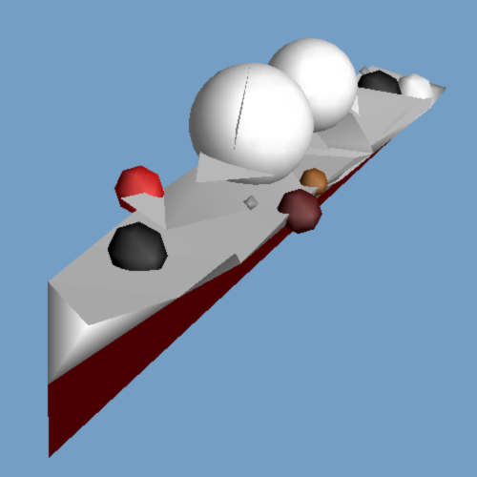
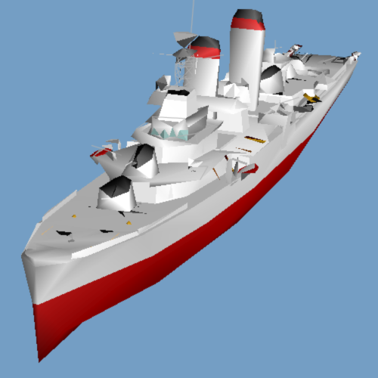

LOD sequence
M¹
M²²
M¹¹⁶
M^{n}
gvspl₁ …
… gvspl_{i} …
gvspl_{n-1}
PSC representation
Notes:
Using these two transformations, we again form a sequence of models by simplifying a given model, but now the simplest model always consists of a single vertex.
Solitary vertices are drawn as either spheres or circles in order to convey the overall shape of the model at coarse levels. Similarly, solitary edges are drawn as either cylinders or lines.

Slide 40
Generalized vertex split
vunify
gvspl
0-simplex
Connectivity:
PM : (log₂n+4)n bits
PSC : (log₂n+7)n bits
1-simplices
2-simplices

Slide 41
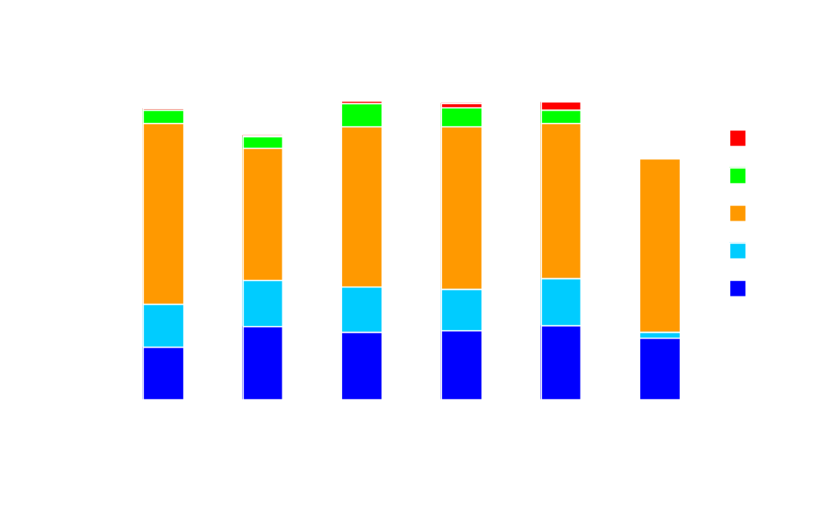
Space analysis
connectivity
connectivity
geometry!
materials
Notes:
This diagram shows the average number of bits required to store each field of a generalized vertex split record in a PSC representation.
The two blue fields encode the connectivity of the model; these require about (log_2 n+7) bits per vertex. That is about 3 bits more per vertex than the PM representation. However, the PSC representation is able to capture topological changes.
Vertex coordinates (encoding the geometry) are quantized to 16 bits and delta-encoded as in the PM representation. As seen in the diagram, geometry still forms the bulk of the space required to store the model.
The green field shows the encoding of material attributes of the faces. These material attributes also include smoothing groups used to infer surface normals (i.e. surface creases).

Slide 42
PSC analysis
M^{n}
PSC
V^{n}
lossless
M¹
K^{n}
gvspl
arbitrary
simplicial complex
single vertex
(+) progressive geometry and topology
(+) no “base mesh”
(–) 3 bit / vertex overhead
(–) slower decompression
Notes:
Here is a summary of the progressive simplicial complex representation.
It is able to encode an arbitrary simplicial complex as a single vertex together with a sequence of refinement transformations that progressively encode both geometry and topology.
The PSC representations retains the advantages of progressive meshes. It defines a continuous sequence of approximating models for runtime level-of-detail control, allows smooth transitions between any pair of models in the sequence, supports progressive transmission , and still offers a space-efficient representation.
Moreover, by allowing changes to topology, the PSC sequence of approximations achieves better fidelity than the corresponding PM sequence.

Slide 43
Summary: Progressive geometry
Connectivity
  group vsplits → forest splits [Taubin etal98]
  permute vsplits
Geometry
  apply smoothing [Taubin etal98]
  local prediction + single delta
Face attributes
  already negligible
Corner attributes
  wedge data structure

Slide 44
Conclusions
Geometry storage overwhelms connectivity,
particularly for simplified meshes.
Progressive representations:
  reasonable compression
  benefits: LOD
Texture coordinates?

Slide 45
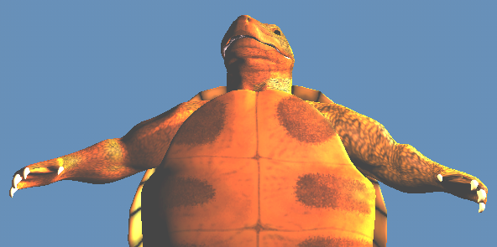
Beyond Gouraud shading
44,000 triangles
Future:
bump mapping
environment mapping
Texture mapping!
~200n bits (JPEG)
[Cohen-etal98]

Slide 46
Simultaneous streaming
progressive
geometry
progressive
texture
network
runtime tradeoff
of geometry & texture
(platform-dependent)
viewer / application

Slide 47
References
H. Hoppe. Progressive meshes. Computer Graphics (SIGGRAPH 96), pages 99-108.
J. Popovic, H. Hoppe. Progressive simplicial complexes. Computer Graphics (SIGGRAPH 97), pages 217-224.
H. Hoppe. Efficient implementation of progressive meshes. Computers & Graphics, Vol. 22, pages 27-36, 1998.
http://research.microsoft.com/~hoppe/

